Slide 1
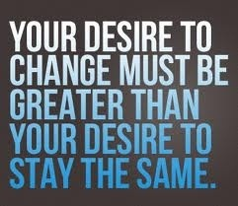
DESIRE
No one can change for you. You got this way on your own. You got this way by making the choices you have made. You got sick because the desire to stay the same outweighed your desire to change. Just as it was your decision to be unhealthy, it is YOUR decision to change the way you want to live your life.

Slide 2
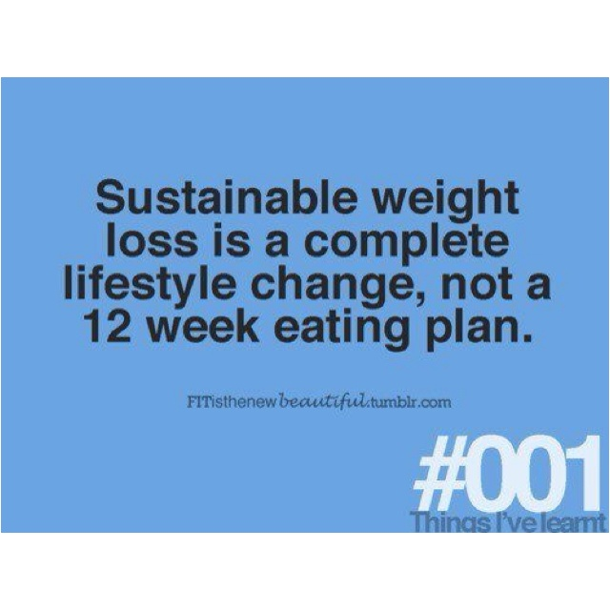
CONSISTENCY
Diets are temporary. Diets provide a stepping stone to developing habits. You cannot expect to eat one way, stop for 12 weeks to lose 20 pounds and then return to old habits without gaining the weight back. It isn’t realistic. It is about changing the way you live your life. It is about sustainability, replacing bad habits with healthy ones. It is about change…not just for 3 months, but FOREVER!

Slide 3
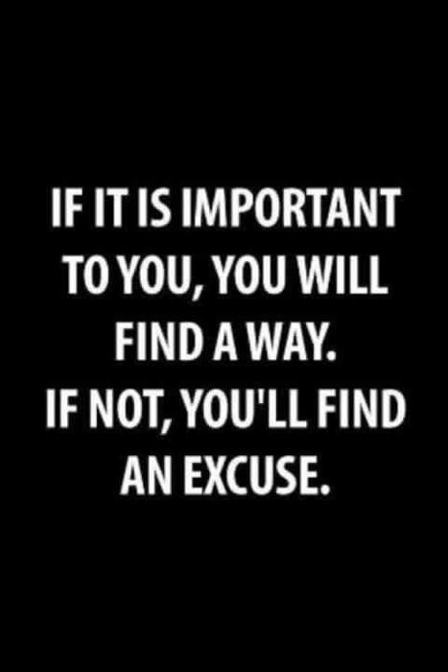
COMMITMENT
If you do not like the shirt your are wearing, you change it. Same thing with pants….socks….shoes. So why, then, if we are unhappy do we not change ourselves? You have to be willing to accept the fact that EVERYONE has the same 24 hours in a day so why can OTHERS do what you say you CANNOT do? It boils down to the simple fact that someone else wants it more. Commit to the changes necessary to become healthy. If you want it bad enough you will find a way. If you are sick and tired of being sick and tired, change is inevitable. That, or you are just making an excuse.

Slide 4
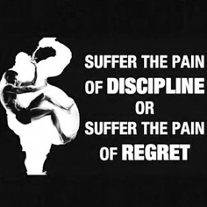
DISCIPLINE
Anything worth having takes work. It also takes a considerable amount of discipline to avoid going backwards. As opposed to saying “I can’t eat that,” or “I can’t drink that,” try substituting “I can’t” with “I don’t.” It makes more sense towards a lifestyle change than a diet or a fad. No one said this was going to be easy. But it is not impossible. Don’t say “I wish I could change.” Just change. Start small at first, but change.

Slide 5

MOTIVATION
Is it to fit into a summer dress, new clothes, a promotion, or is it something more important to you like ridding yourself of type 2 diabetes, high blood pressure or high cholesterol? Whatever your motivation is, keep that as your focus. When you feel like quitting, remember what it was that made you want to start in the first place. Put all of your fears and your self-doubt in the rear view mirror. Press forward and never look back.

Slide 6
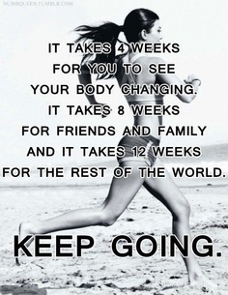
PERSISTENCE
Getting unhealthy did not happen overnight. So you have to be willing to be patient and persist through the urge to stop when the results do not happen overnight. Remember, in order to become you healthy, you have to change your life. Not for 4 weeks, or for 12, but forever. Keep going forward every day and good things will happen. It won’t happen right away but it WILL happen!

